Slide 1
Basic introduction
MVC is an application architecture. It was initially develop for the SMALTALK language.
The main objective was to:
« Structure an application with Graphical User Interface »
This model is an architecture concept that propose to:
« separate an application into 03 independent entities: the model (data), the processes and the View (GUI) so that each part or entity can be developed without knowing the implementation details of the other parts »
1

Slide 2
Basic introduction
Initially developed for GUI, this architecture (MVC) can be transposed on web application for other type of application in the form of 3-tiers architecture:
The view implemented in Java by JSP (Java Server page) for example
The controler implemented in Java by Servlet or Javabeans
The Model for which several mechanism can be used to have access to the data.
2

Slide 3
Basic introduction
The Model: represents all data of the application generally store in a database.
The View: That corresponds to HMI (Human Machine Interface) or GUI
The Controller: Which ensure the exchanges between View and Model with the help of business component.
We have two type of MVC: type1 & type2
3

Slide 4
MVC Type1
In this model, each request is dealt by a Controller which is a Servlet (in Java technology). That servlet deals the request, ask for model elements if necessary and redirect the request toward a view (JSP or simple HTML). The view has the function to create the user answer.
This figure describe what happens:
4

Slide 5
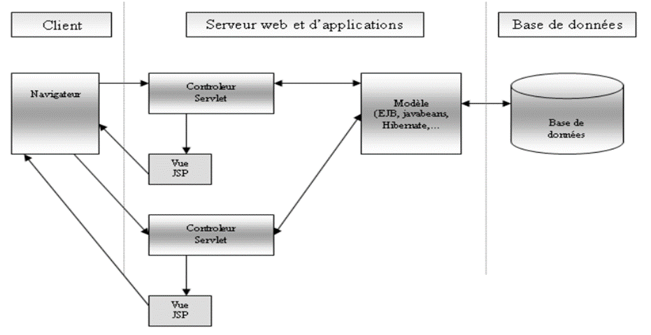
MVC Type1
5

Slide 6
MVC Type1
As we can see, the problem with this type of MVC architecture is the multiplication of the number of Servlet.
In fact, the implementation of several Servlet impose writing a lot of Code and each Servlet must be declare in the web.xml file. We need one controller (Servlet) for each request.
6

Slide 7
MVC Type2
Normally, this model propose to reduce the number of Servlet used to 1.
We have to use only one Controler (Servlet).
This Servlet has the function to ensure all the workflow of treatments for all the received HTTP request.
MVC 2 keeps all the MVC principle but divise the Controler in 02 parts by imposing a unique entry point for all application (first part of the controller) which will determine for each received request the business treatment to be invoked dynamically (second part of the controller).
7

Slide 8
MVC Type2
A web application based on MVC2 use only one servlet as a controler which is in charge of all request. According to that request, the servlet calls the dedicated business treatment generally encapsulated in a Java Class. The below figure expose the functionning:
8

Slide 9
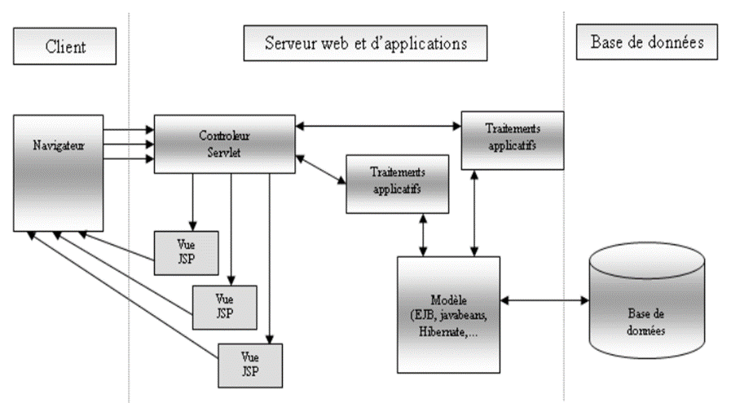
MVC Type2
9

Slide 10
MVC Type2
In this MVC2 the lifecycle of a request is:
The client send a request to the application. The request is handled by the servlet that act as a controller.
The servlet analyse the request and call the dedicated class that contain the treatment needed
The calling class execute the treatment and can invoke another business objets for it.
The result returns to the servlet that is in charge of it, and this servlet can now redirect the request towards the view (JSP page)
The generated JSP can be sent as a response to the client.
10

Slide 11
MVC Type2
There exists a lot of framework that are based on MVC2:
Spring MVC, Struts and so on.
We talk about FRAMEWORK there and it is important for us to clarify some aspect before move because in all our example we need to use a framework to develop.
11

Slide 12
FRAMEWORK
What is a framework?
A framework is a platform for developing software application. It provides a foundation on which software developers can be based to build programs or software for a specific platforms.
It is not a programming language
It is not an IDE
It is consider as compulsory for a programmer
12

Slide 13
FRAMEWORK
Why is it not a programming language?
A programming language is a set of syntax, grammar, semantics that programmers are required to support and respect.
While
A framework is a cohesive set of library code that together simplifies programming in any given language. Means each framework is based on a language. And it allows to take advantage of all the language specifications and it allows to respect the best practice in coding in each language.
13

Slide 14
FRAMEWORK
Why is it not an IDE (Integrated Developement Environment)?
An IDE is the software you use to deploy and develop with a framework. A framework is a set of both librairies and best practices that help the programmer to not re-invent the wheel and provide a set of guidelines on how to develop.
14

Slide 15
FRAMEWORK
Why is it consider as compulsory for a programmer?
In fact, for each software a programmer have to build, the requirements can be divided in 02 classes:
Functinal requirements: which respond to the question why the software is needed? The software is to resolve which problem? According to the end user.
Non-functional requirements or technical requirements: This class is composed by all the requirements that the end user can forget to precise but verify if it is filled after deploying the software. It canot precise it in the book of software specification but canot accept an application in which all those aspect is not taken in consideration.
15

Slide 16
FRAMEWORK
Why is it consider as compulsory for a programmer?
In that non-functional requirements we have:
Perfomances: We talk about Time response, availability, failure resistance, load escalation issues (1, 2 or more client can be simultenously connected)
Maintenance: A software need to be adapt with the time growing, must be close for modification and open for extension. Means the software must be implemented such that for evry other specification, the programmer don’t need to redevelop some part and redeploy but just develop a new extension and deploy it.
16

Slide 17
FRAMEWORK
Why is it consider as compulsory for a programmer?
In that non-functional requirements we have:
Security aspect: A software need to be secure against all the knowing attacks.
Portability: A software need to be executed on several different platform (OS)
A software need to be able to communicate with other application
A software need to provide services to several types of client (desktop, mobile phone, etc.)
17

Slide 18
FRAMEWORK
Why is it consider as compulsory for a programmer?
Due to all those aspects, it is not a good idea (a huge risk) for a programmer to think to build a software product from scracth. Because, he needs in addition of functional requirements to fullfill all those technical aspect with his own code.
With the help of a framework (the validated one), all those technical aspect can be consider as implemented by default. A programmer assume it and just configure it to face his own particularity.
So it can be more focused on the functional requirements without loosing some other important aspect.
18

Slide 19
FRAMEWORK
Why is it consider as compulsory for a programmer?
Due to all those aspects, it is not a good idea (a huge risk) for a programmer to think to build a software product from scracth. Because, he needs in addition of functional requirements to fullfill all those technical aspect with his own code.
With the help of a framework (the validated one), all those technical aspect can be consider as implemented by default. A programmer assume it and just configure it to face his own particularity.
So it can be more focused on the functional requirements without loosing some other important aspect.
19

Slide 20
FRAMEWORK
Follow the book: BEGINN
From page 6 (21 / 446) to 8 (23 / 446)
From 45 (59 / 446) to chapter on JSP.
Specification of the project in which all the concepts needs to be apply.
To change the tomcat port, double click on it in the server view and check where the port number is
20

